Slide 1
User Role Management
With Apache Cassandra

Slide 2
Introduction
What is Apache Cassandra?
Distributed NoSQL database
High availability and scalability
Key Features:
Linear scalability
Fault tolerance
Supports large amounts of data

Slide 3
Project Overview
Objective: User Role Management System
Components:
Docker containers for Cassandra
Python scripts for database operations

Slide 4
Technical Details
Docker Setup:
„docker-compose.yml“ Configuration
Cassandra Setup:
Creating Keyspace and Tables
Python Scripts:
„cassandra_client.py“ for database operations
„main.py“ for inserting and querying data

Slide 5
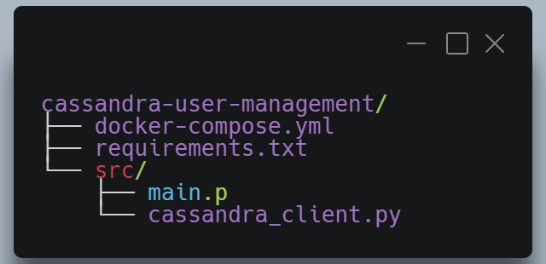
Prerequisites
Software Requirements:
Docker
Docker Compose
Python 3.11
Directory Structure:

Slide 6
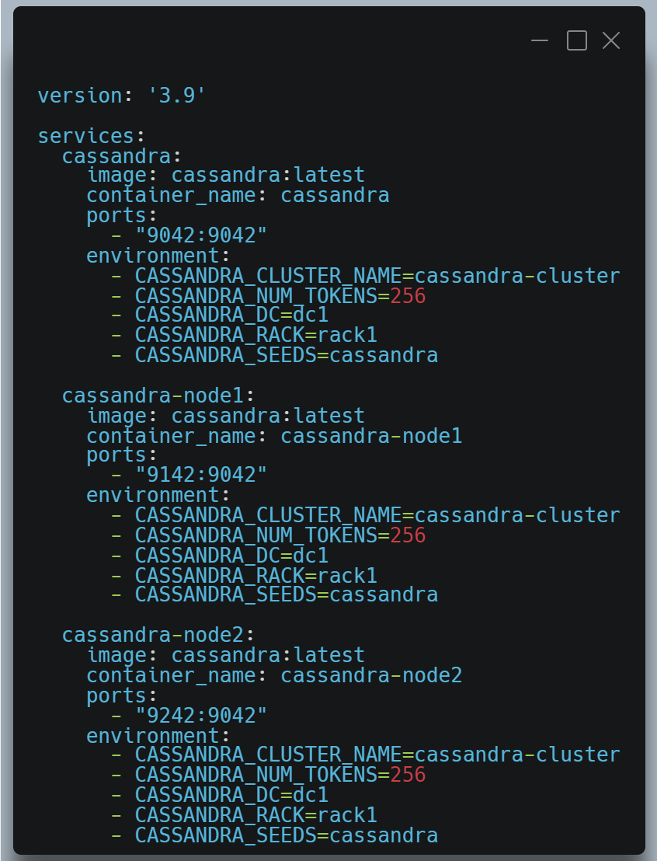
Docker-Compose Configuration

Slide 7
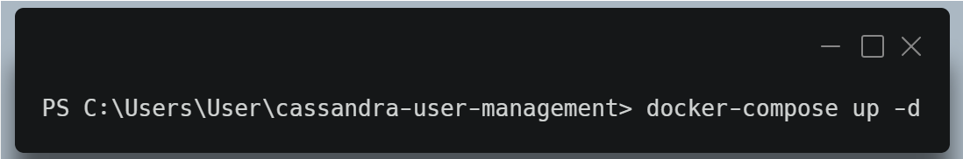
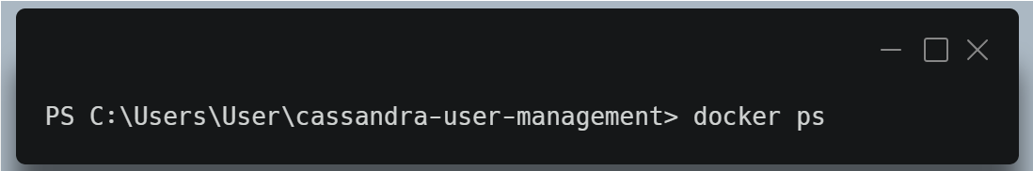
Starting Docker Containers
Start the Docker containers:
Verify the running containers:

Slide 8
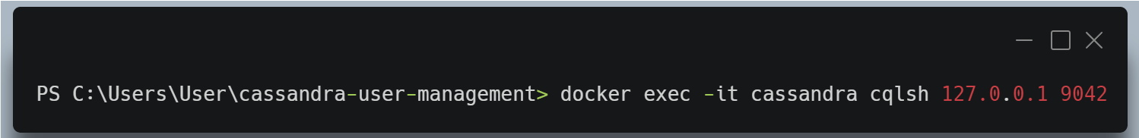
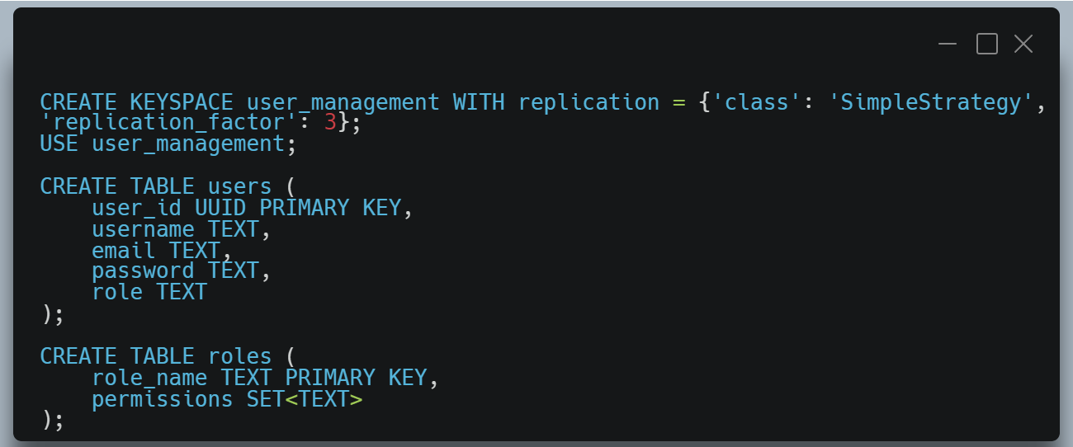
Cassandra Setup
Connect to „cqlsh“:
Create Keyspace and Tables:

Slide 9

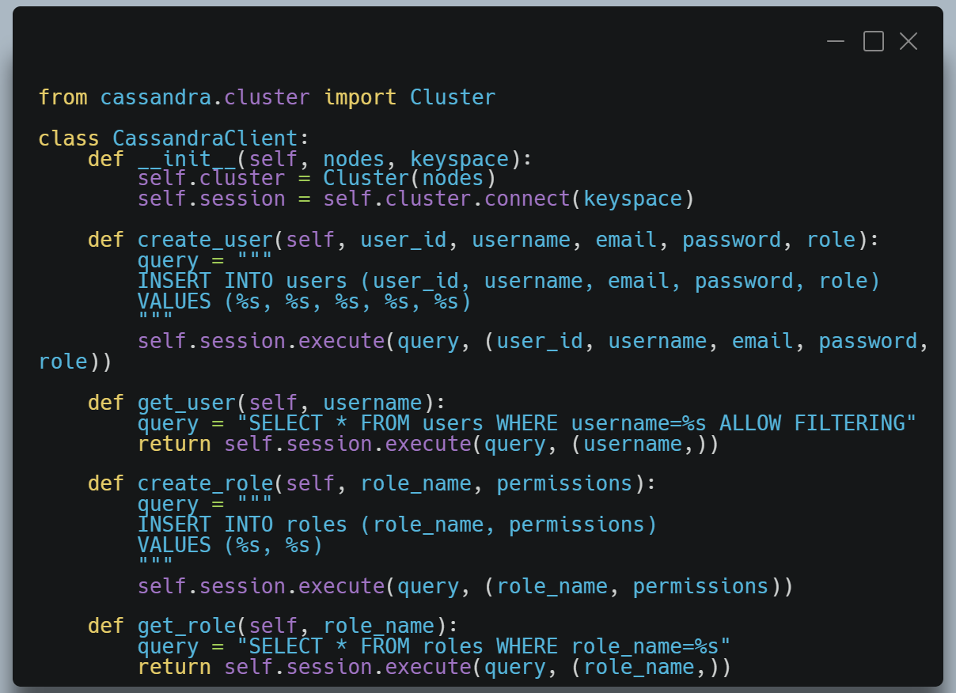
Python Script Setup
Create a „requirements.txt“ file:
Create a „cassandra_client.py“ file:

Slide 10
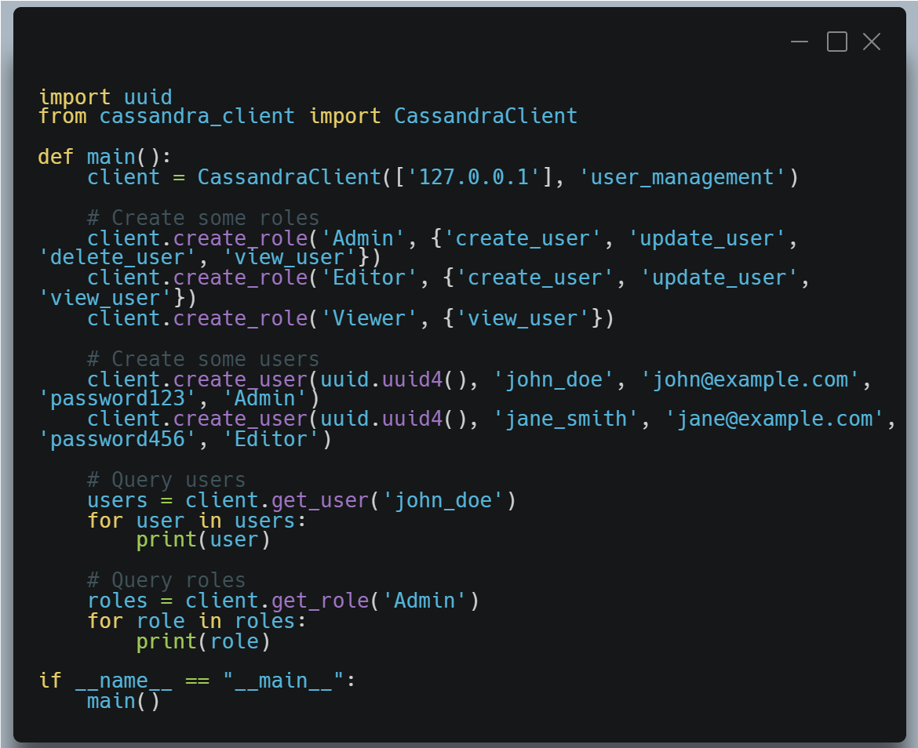
Python Script Setup
Create a „main.py“ file:

Slide 11
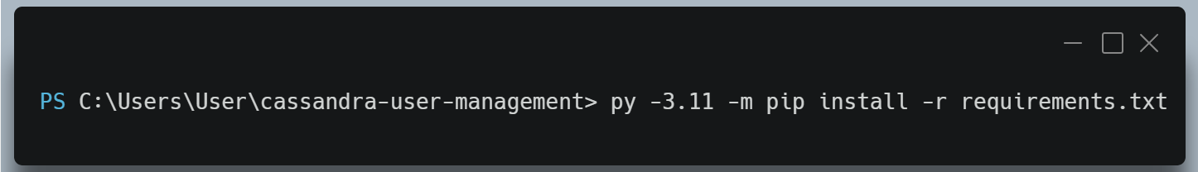
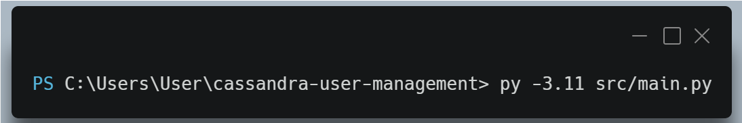
Install Dependencies & Run the Python Script
Install Python dependencies:
Run the script:

Slide 12
Results
Output:
Users and roles data will be prinbted in the console.

